Slide 1
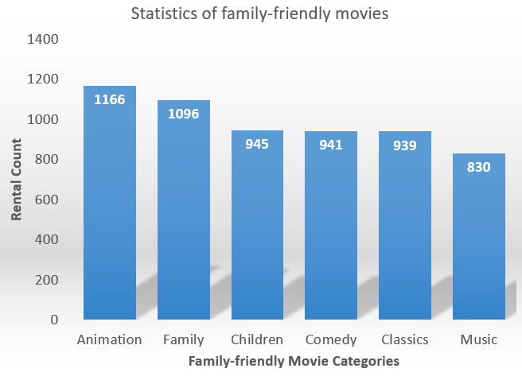
Question 1: How does the family-friendly movies compare based on the number of times each has been rented out?
<visualization>
This chart shows that Animation category of the Family-friendly movies has the highest rental patronage with rental count of 1166 while Music category has the lowest rental patronage with count of 830.

Slide 2
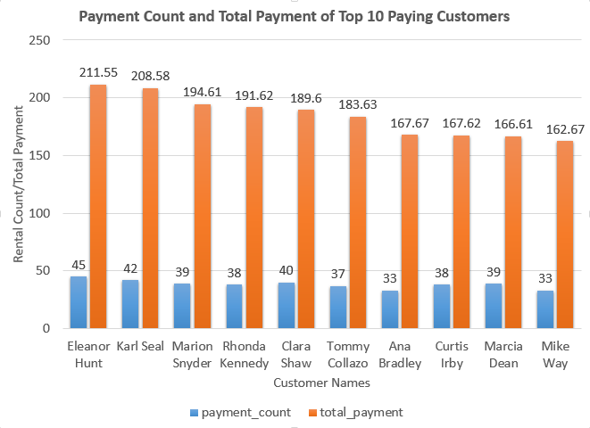
Question 2: What is the payment count and total payment of the top 10 paying customers in the year 2007?
<visualization>
This chart shows that Eleanor Hunt has made the most rental patronage with a rental count of 45 and total payment of $211.58.

Slide 3
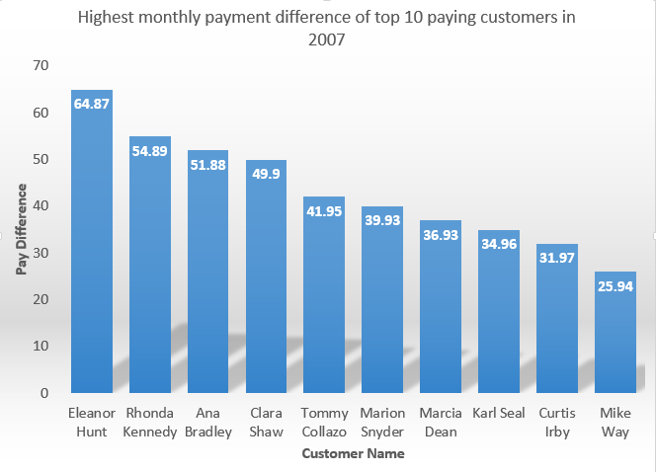
Question 4: Which of the top 10 paying customers has the highest monthly payment difference in 2007?
<visualization>
Of the top 10 paying customers, Eleanor Hunt paid the maximum difference of $64.87 in 2007.

Slide 4
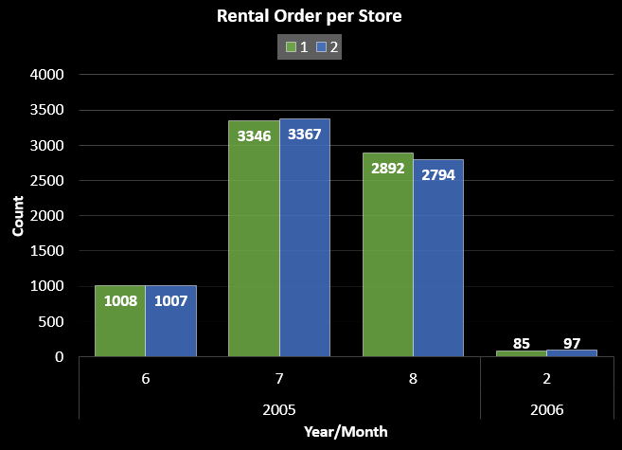
Question 4: How does the two stores compare in their count of rental orders during every month for all the years we have data for?
<visualization>
This chart shows that there is no major difference in the rental orders for both store 1 and store 2 based on the years and months available.

